Slide 1
CS2164 Lesson 2
Intro to programming using C
Instructor: Gustavo Sandoval
gustavo.sandoval@nyu.edu

Slide 2
Grading

Slide 3
Recap from last class

Slide 4
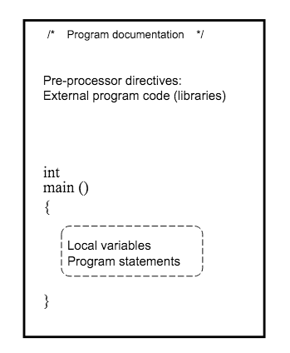
Basic Structure of a C program

Slide 5
Steps to run a program
Edit (using your favorite editor)
Compile
Execute

Slide 6
DEMO
Another way, Compile quickly online:
http://www.tutorialspoint.com/compile_c99_online.php
Hello World

Slide 7
Marathon.c
Demo

Slide 8
Dissection
/* the distance of a marathon in km */ | comment
#include <stdio.h> | Include about std library
int main() | Define a function called main that returns an integer and takes no arguments (parameters)
{ | Brackets becaeuse beginnning of a function
int miles, yards; | Declaration using the int keyword. It informs the compiler that the variables following it are of integer values
float kilometers; | declaration using the floating point data type
Notes:
Int is a fundamental data type
The two

Slide 9
Dissection continued
Miles = 26; Yards = 385; | Assignment statements. We asign miles the value 26 and yards the value 385
Kilometers = 1.609 * (miles + yards / 1760.0); | Another assigment statement. The * is multiplication The + is addition The / is division. Operations inside the parentheses get executed first. Since Division has higher precedence it gets executed first then addition.

Slide 10
Preprocessing directives

Slide 11
The C compiler has a preprocessor built in
Lines that begin with # are called preprocessing directives.
A couple of it’s uses are:
Including files: #include <stdio.h>
Constants: #define MILES 26

Slide 12
Marathon.c
With #define

Slide 13
PrintF & scanf intro

Slide 14
printf is used for output
Scanf is used for input
You can use different conversion specifications for each.
You can also specify the field width
examples:
Printf(“%c%3c%5c\n”, ‘A’, ‘B’, ‘C’);

Slide 15
Demo

Slide 16
Printf conversion chars
Conversion character | How the argument is printed
c | character
d | decimal
e | Floating point in scientific notation
f | Floating point
g | In the e or f format whichever is shorter
s | As a string

Slide 17
SAMPLES
%d | Print as a decimal integer
%6d | Print as a decimal integer , at least 6 characters wide
%f | Print as a floating point
%6f | Print as a floating point, at least 6 characters wide
%.2f | Print as floating point, 2 characters after the decimal point
%6.2f | Print as floating point, at least 6 characters wide and 2 characters after the decimal point

Slide 18
SCANF
Scanf is analogous to printf except that it’s used for input
Scanf (“%d”, &x);
Why the & ?
It’s the “address of” operator

Slide 19
Scanf conversion chars
Conversion character | How characters are converted
c | character
d | Decimal integer
f | Floating point (float)
lf or LF | Floating point (double)
s | String

Slide 20
Demo: echo.c

Slide 21
Flow of control

Slide 22
IF STATEMENTS
So far our programs have executed sequentially
We need a mechanism to alter the flow of control
IF and IF – ELSE statements

Slide 23
Demo: IF statements

Slide 24
DEMO
Write a program that inputs a number and if the number is less than zero prints negative otherwise prints positive

Slide 25
Looping mechanisms

Slide 26
LOOPING MECHANISMS
How would you write a program to print “hello world” 2x ? 10x ?
FOR
WHILE
Let’s try it…

